Slide 1

PANIMALAR ENGINEERING COLLEGE
Department of Computer Science and Engineering
Title of the Project: Door Automation based on Speech Command Pin Using Android Smartphone.
Team Members with Register number
ANDREW KEVIN JONES.J -211417104016
KAMALNATH V-211417104104
KAMESH RAJA P-211417104106
Project Guide:
Mr. Krishnamoorthy
Batch Number:E7

Slide 2
ABSTRACT
The growth of technology make smartphone can control the home appliances. An automated device can work more flexible and efficient, including the use in unlocking door.
For busy family or busy people, it is not easy to get out of the seat only to reach the door for unlocking people that already have known and made appointment before.
The design of proposed method is based on Android smartphone application, Bluetooth module and Android smartphone application is used for serial communication to the Bluetooth module which is connected in controller to unlock the door.
Besides it has low cost, Bluetooth based wireless home automation system can be easy implemented in the home.
The suggested system is tested and it gives the expected system with more feature as authentication, either with speech command or with pin.
Speech command enacted to the system is also tested the Bluetooth connectivity.

Slide 3
LITREATURE SURVEY
TITLE | AUTHOR NAME | YEAR | FINDINGS
1) Design and Prototype Implementation of SMS Based Home Automation System. IEEE International Conference on Electronics Design Systems and Applications (ICEDSA), pp. 162-167DOI:10.1109/ICEDSA.2012.6507788. | ELKamchouchi, H., and ElShafee, A | 2012 | The research work from H. El Kamchouchi and Ahmed ElShafee provided full functionality to control home appliances uses SMS technology to exchange data via GSM Network. But, SMS based technology lack of Graphical User Interfaces (GUIs).
2)Home Automation Networks: A Survey. Computer Standards & Interfaces, 1-41. DOI: 10.1016/j.csi.2016.08.008. | Toschi, G. M., Campos, L. B., and Cugnasca, C. E. | 2016 | . The method like on off button is not really secure to be implemented to the gate or door. Hence, this work utilize more feature to control the door by adding authentication via speech command or pin. Through the GUI of android mobile application, the flexibility is in the hand. Additionally, the user will feel more secure because it has authentication and also the android mobile application is still user friendly to be used. Generally, a simplified secure architecture is provided in this work for realizing home automation
3) . Ubiquitous Smart Home System Using Android Application. International Journal of Computer Networks and Communications (IJCNC). 6: 33-43 | S.KUMAR | 2014 | Shiu Kumar proposed smart home design application that allows owner to manage their home through internet. Its need a PC tend the information to the internet, so a PC is used as a server that increases the price and power consumption while others need web page hosting that need extra cost also
4)Smart Living Using Bluetooth Based Android Smartphone, International Journal of Wireless and Mobile Networks.5: 65-72. | M. Yan and H. Shi | 2013 | He had examined home automation system using RFID, Wireless Sensor Network (ZigBee) technology and GSM. ZigBee is low power wireless technology used for monitoring and controlling various devices

Slide 4
EXISTING SYSTEM
The Existing system reached the expectations,
by demonstrating a relevant flexibility in adapting
to different scenarios and properly responding to
the user voice requests.
However, when it comes to processing time, the
Google Speech Recognition Engine seemed to
take a while to deal with the voice requests. In
addition, there were a few instances that the user
speech could not be recognized.

Slide 5
PROPOSED SYSTEM
The proposed system will have following features:
Arduino .
Devices controlled through android app, also through voice commands.
Mobile control.
Bluetooth .
LPG - Notification on mobile side - Buzzer goes on.
Temperature - Notification on mobile side - One device on.
Password for android app.
If any person inside the home then automatically device turn on and vice versa.

Slide 6
TECHNOLOGY STACK
HARWARE MODULE:
ARDUNIO
BLUETOOTH MODULE
LPG SENSOR
RELAY
DC MOTOR
SOFTWARE MODULE:
CODING LANGUAGE: EMBEDED C

Slide 7
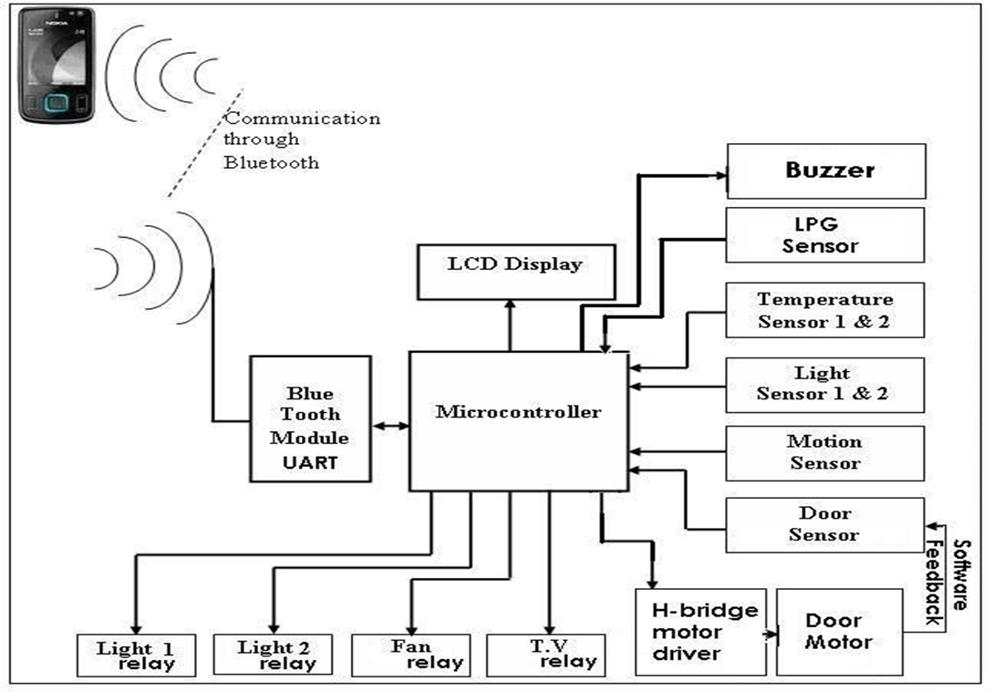
System Architecture Diagram

Slide 8
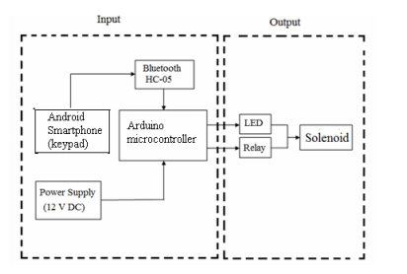
CIRCUIT DIAGRAM

Slide 9
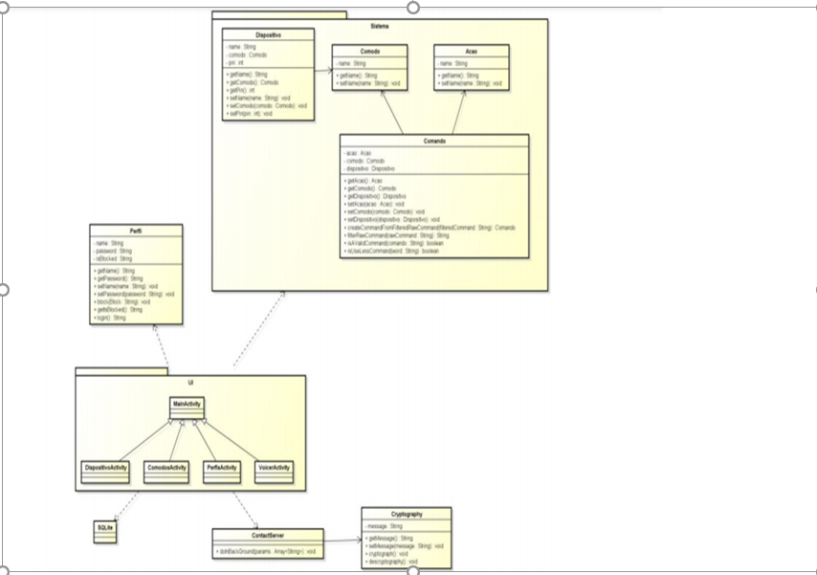
CLASS DIAGRAM

Slide 10
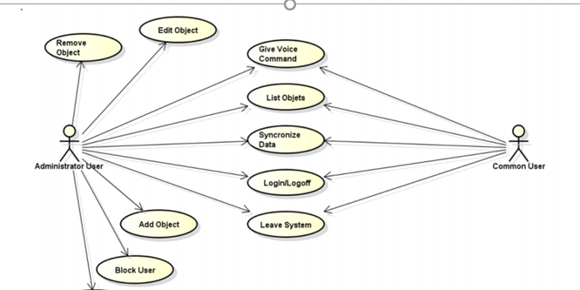
USE CASE DIAGRAM

Slide 11
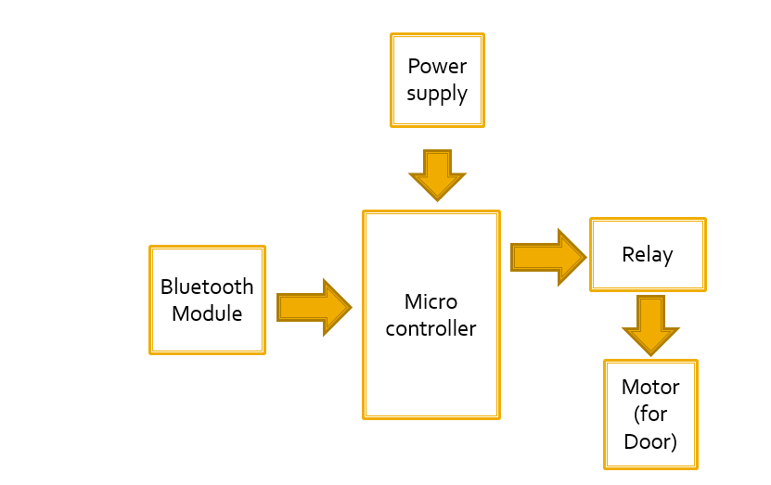
BLOCK DIAGRAM

Slide 12
Speech Command Working:
1. Initialize the password of speech command
2. Call speech to text google library
3. Send the text from spoken word via Bluetooth
4. Receive the text data in the Arduino microcontroller
5. Check the protocol, if the first input character is #, the data is true for the system

Slide 13
6. If not, do nothing
7. If true continue check, the next flag must be 0 to indicate
the use of speech command authentication
8. Then continue check, if the next flag serial setting is 1, it
is the command to set new command password, then
update the received detected text in the next serial data
as saved password in the EEPROM
9. If the next flag serial setting is 0, it is the command
protocol to open the door.
10. Do the authentication, If the command password
received are exactly the same with the saved password,
the relay will turn HIGH to control the solenoid to open
the door
11. If not, shows the warning in the android application

Slide 14
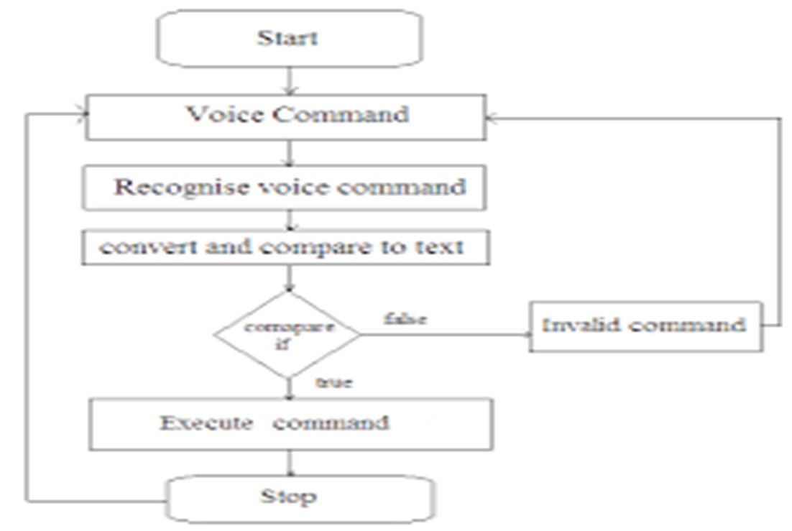
FLOW CHART WORKING MODEL

Slide 15
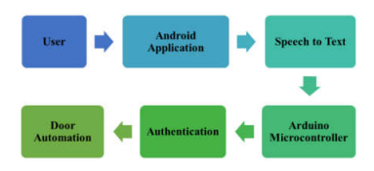
SPEECH COMMAND DIAGRAM

Slide 16
BENEFITS OF THE PROJECT
In speech command, users can easily open the door with say it.
Another work being tried is open the door with pin.
It can help disabled people with speech impaired to be still able use the application.

Slide 17
MODULE DESCRIPTION
CONNECTING TO THE BLUETOOTH:
Android Phone’s Bluetooth should be connected to the same app in the android phone for working of the door automation .A Kit containing the hardware modules can be ON during this Time.
USING THE VOICE COMMAND IN THE APP:
The Application already developed contains inbuilt commands and also a google voice recognizer where we need to speak the command to make the door automate .The Algorithm to this also works along with this to make sure the command is executed successfully.

Slide 18
VOICE OUTPUT :
The voice command given by the user is then recognized by google and undergoes a verification and the expected result that is door is automated by its own successfully .

Slide 19
MODULE WORKING DESCRIPTIONS
In our system, we use the speech recognition Google API to control the lock/unlock of the door using a human voice command. The main advantages of this API are that it can convert Audio speech to text, and that it has a vast database Easy to implement.
Here the user sends a voice command to the smartphone with its microphone through the interface presented in which converts the speech to text using the speech recognition Google API, then, analyzes this text to interpret the message and then sends the locking command to the door

Slide 20
STEPS TO IMPLEMENT THE MODULE
Pair your Android’s Bluetooth to HC-05 module.
Open the app and connect to HC-05 again.
Your voice controlled home automation system is ready to work.
Touch ‘Speak’ icon on the app, say ‘Door Open’ in front of your smartphone to turn the appliance and it will Display ‘Door Open’.
The DC motor Moving Will Indicate in That the Command has been performed and the result is showed in the board

Slide 21
TESTING
TEST CASE ID | TESTCASES | PRIORITY | INPUT TEST DATA | TEST CASE DESCRIPTION | EXPECTED RESULTS | ACTUAL RESULTS | PASS/FAIL
TCO1 | CONNECT TO THE BLUETOOTH | A | CONNECTING BLUETOOTH WITH THE ANDROID APP | BLUETOOTH IS CONNECTED TO PRESENT DOOR AUTOMATE | ANDROID PHONE BLUETOOTH AND APP BLUTOOTH CONNECTED | APP BULIT NEED TO CONNECTED WITH PHONE BLUETOOTH | PASS
TCO2 | USING VOICE COMMAND | A | GOOGLE ACCPETS VOICE COMMAND | STORED COMMANDS OR NEWELY ADDED COMMANDS GOOGLE RECOGINIZES IT | COMMAND IS EXECTUED SUCCESFULLY BY GOOGLE | APP WILL RECOGINIZE AND WORK ON THE COMMAND | PASS
TCO3 | VOICE OUTPUT | A | THE VOICE IS CHECKED AND OUTPUT IS PRESENTED | THE VOICE IS RECOGNIZED | DOOR SHOULD BE AUTOMATED FOR THE COMMAND | AFTER VERFIED SHOULD DISPLAY THE OUTPUT ON THE BOARD | PASS

Slide 22
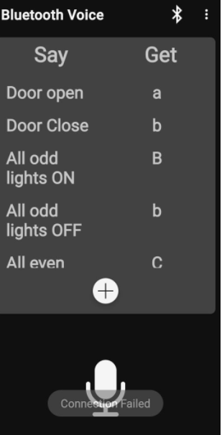
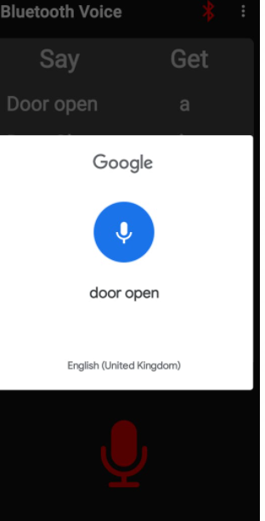
SCREENSHOTS

Slide 23
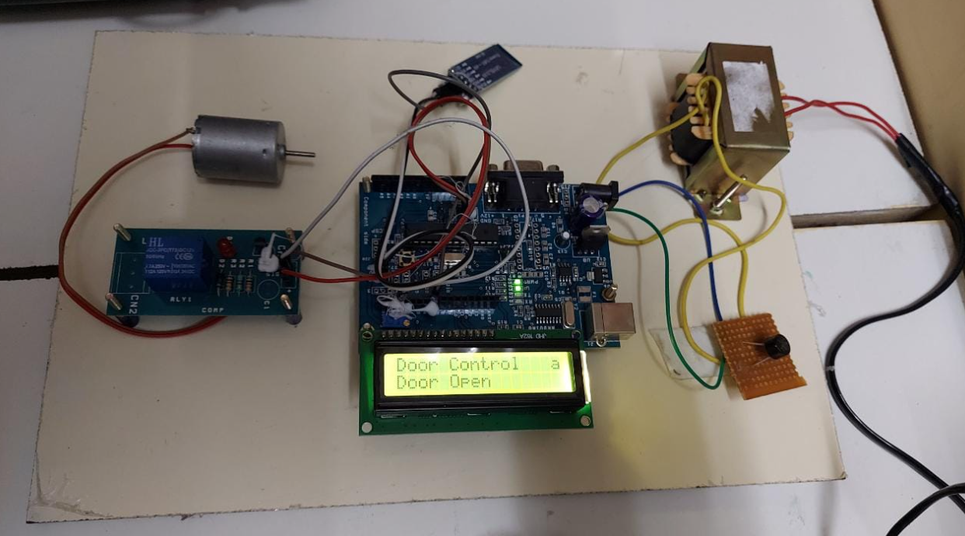

Slide 24
CONCLUSION
In this Project, we have shown the design and features of a Smart Home Automation System. It is Bluetooth based, hence wireless and can be flexible in terms of cost. It has a special feature for smart speech sense, which would decode user’s sentences into appropriate commands.
It requires authentication details as a medium of security, thus preventing the use of application by unauthorized users. The system also connects with sensors, thus helping In future, the system could use more concepts of Artificial Intelligence so as make it more user friendly and increase the automation. Another function that may be added is developing the system for different regional languages.

Slide 25
REFERENCES
Alper Gurek, Caner Gur, Cagri Gurakin, Mustafa Akdeniz, Senem Kumova Metin, Ilker Korkmaz, “An Android Based Home Automation System”, 2013 10th International Conference on High Capacity Optical Networks and Enabling Technologies(HONET-CNS), December 2013.
D.Naresh, B.Chakradhar, S.Krishnaveni, “Bluetooth Based Home Automation and Security System Using ARM9”, International Journal of Engineering Trends and Technology (IJETT), Vol. 4 Issue 9, September 2013.
R. Piyare and M. Tazil. (2011). Bluetooth based home automation system using cell phone. IEEE 15th Tnternational Symposium on Consumer Electronics (ISCE), pp. 192-195. DOI: 10.1109/ISCE.2011.5973811

